Slide 1
Wordshark online
(PART 1 - 16 brief frames)

Slide 2
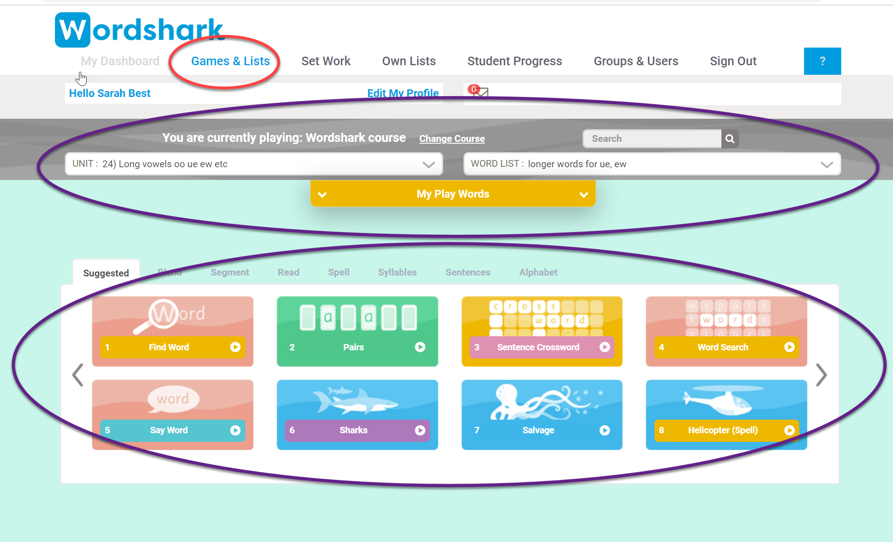
Explore the lists and games 😃

Slide 3
Lists
Games

Slide 4
Wordshark: 3 modes of running …

Slide 5
SUPERSHARK
SET WORK
FREE PLAY

Slide 6
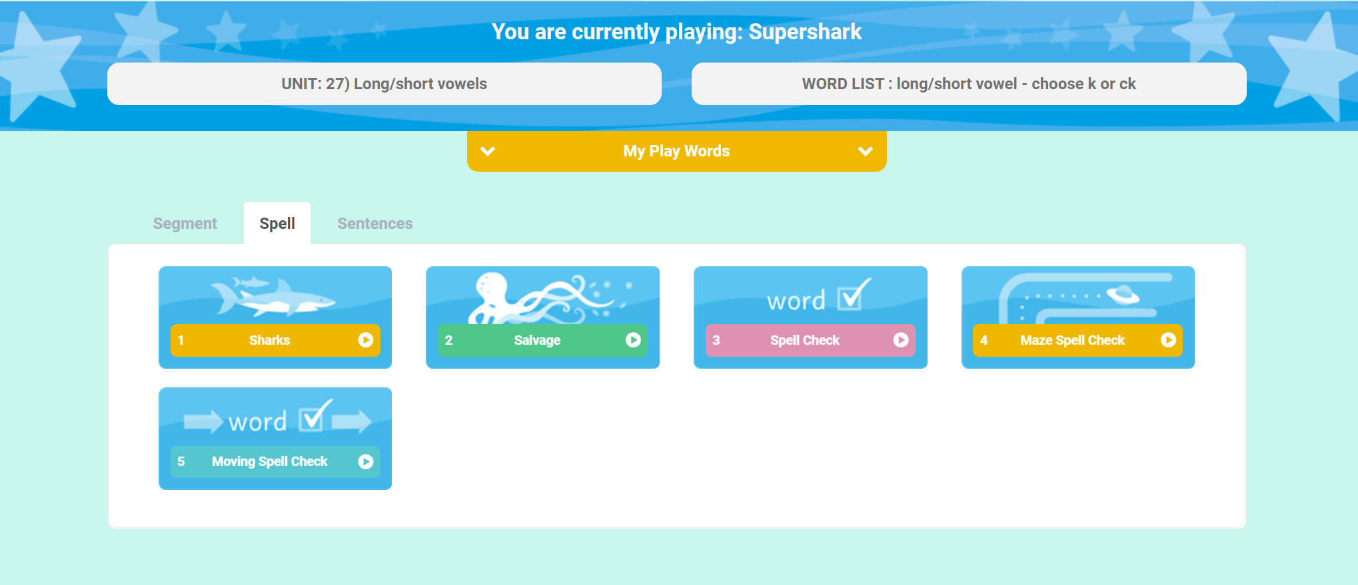
Supershark Progression
Supershark automatic progression –
It runs all the time with minimum input

Slide 7
Supershark - Automatic progression
Test and placement:
Once added to the system, students are automatically given a test and placed in the Wordshark course and are moved through at their own pace – needing at least 85% correct to move on
Make sure you have a summary of this course
- 44 units divided into individual word lists:

Slide 8
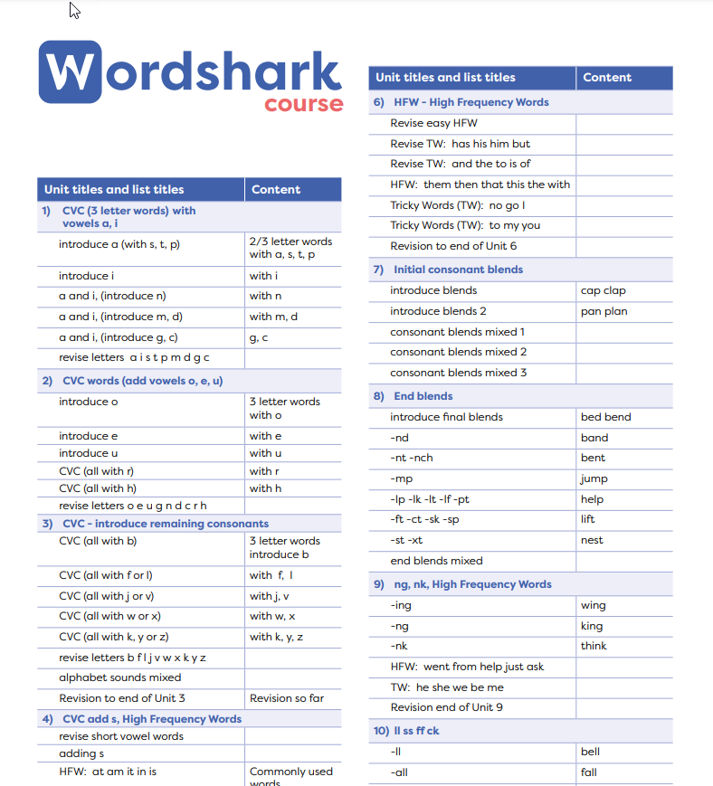
Wordshark course summary - available under Help

Slide 9
Follow progress in Supershark
Check out where students are working in Supershark
Supershark records are built overnight
Use ‘All’ for a group report
Or select
Individual student reports

Slide 10
If needed - you can manually move a student at any time to a new position in Supershark

Slide 11
(in addition to Supershark)
SET WORK
Use published lists
or create your own lists – using the easy set-up tool

Slide 12
Set work progress reports
Are built all the time – 75% or more accuracy is needed
Periodic spell test games ensure you can track progress
Access the Set work reports under ‘Set Work’

Slide 13
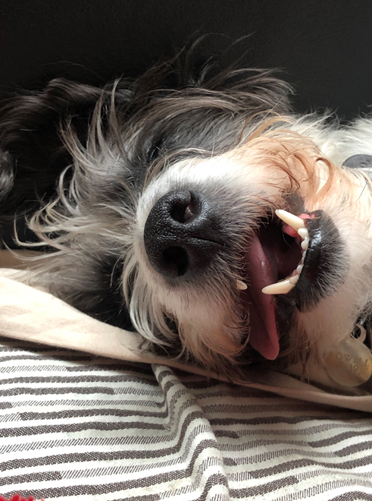
ADMIN
Stay awake for a bit on Admin!

Slide 14
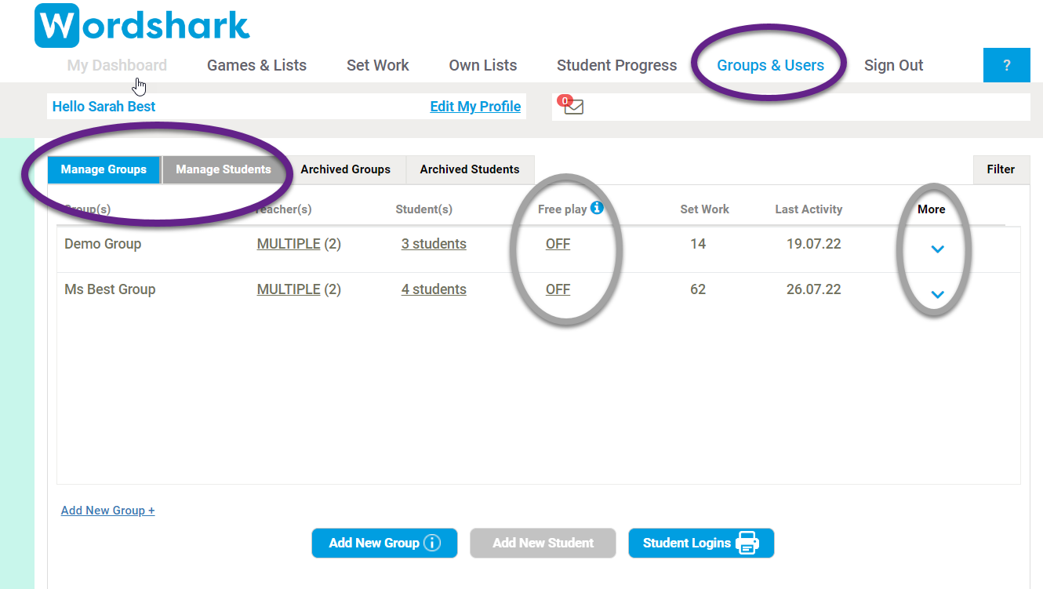
Your Administrator adds the teachers…
Teachers then get their logins by email (check junk mail!)
Both students and teachers can be in more than one group
Teachers check any group(s) and student(s) they have been given
Teachers can
add groups
add students
re-arrange their groups

Slide 15
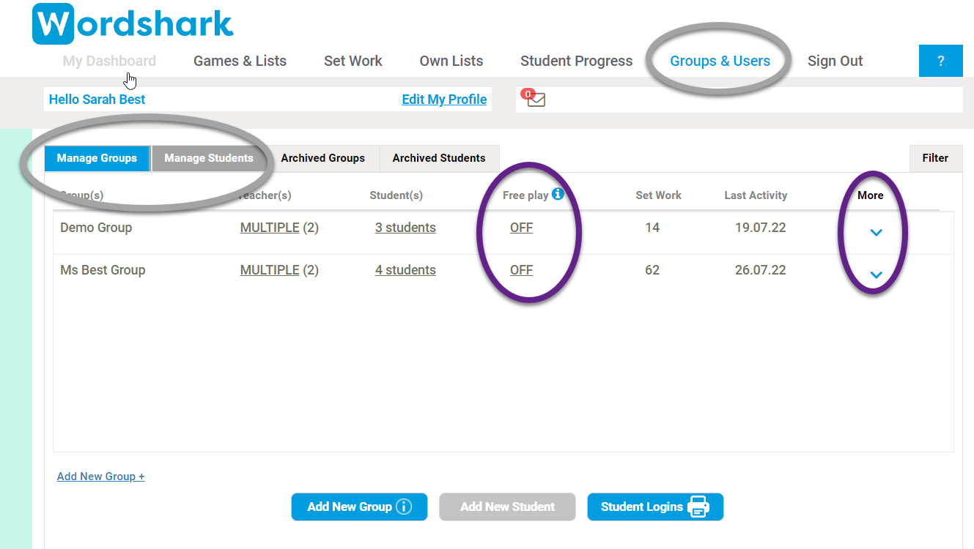
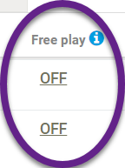
Teachers can also…
Distribute student logins
Change settings
Grant Free Play
(students can choose any list)
FREE PLAY

Slide 16
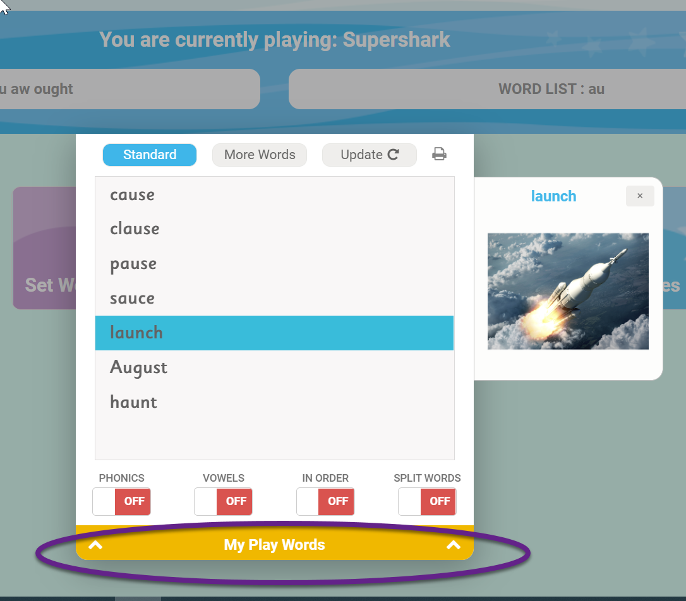
Don’t forget to introduce your students to their ‘Play words’ !

Slide 17
A simple way to run the program is to rely on the automatic course – Supershark
Running all the time by default
And in addition
Set work (maybe including OWN lists)

Slide 18
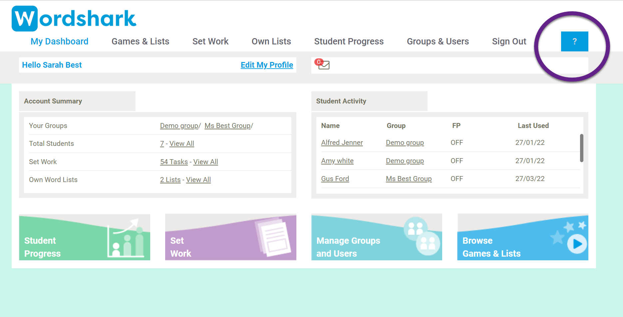
Wordshark online
Help
button
Part 2 to follow – Introducing Wordshark
to your students (7 slides)

Slide 19
PART 2 Introducing the program to your students
(7 slides)

Slide 20
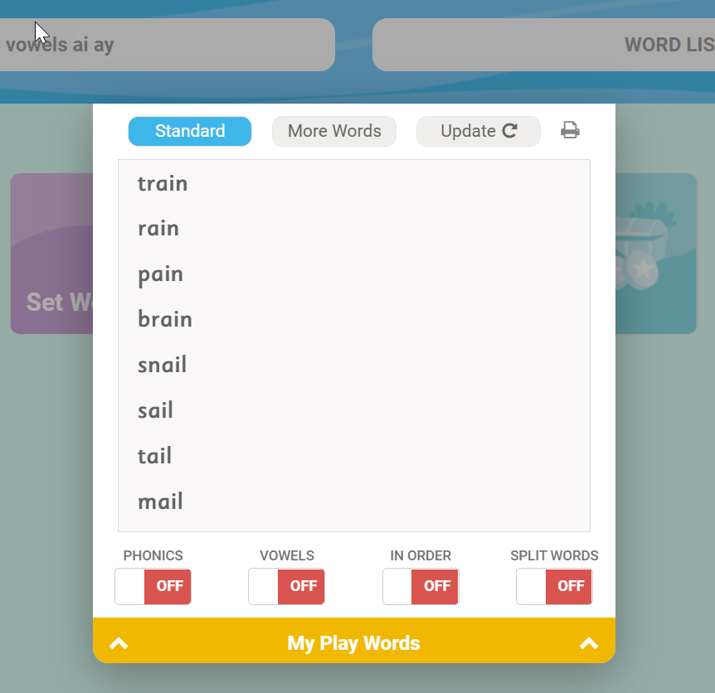
Firstly - Open up your Play Words

Slide 21
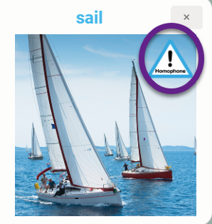
Look at the words
Click on them to hear them spoken
Homophones will have a sign and say a clue out loud
for example for ‘sail’ you will hear ‘Sail: sail a boat’
And for past tenses you will see a sign

Slide 22
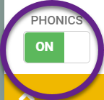
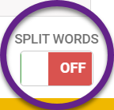
Use the sliders at the bottom
Use the sound buttons – dashes show any letters working together to represent a single phoneme
Click on each word to hear the separate sounds followed by the whole word
‘Split words’ will show any syllable splits

Slide 23
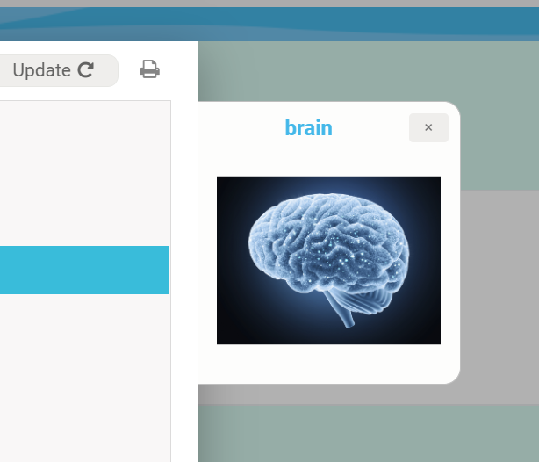
Note any illustrations for the words
Note any tricky bits of words and how they look

Slide 24
Be the detective – most important of all
Work out why these words have been put together in one list
What is the common theme?
Ask if you are not sure

Slide 25
Then play the games
You will be offered different selections of games to play and a score at the end of each

Slide 26
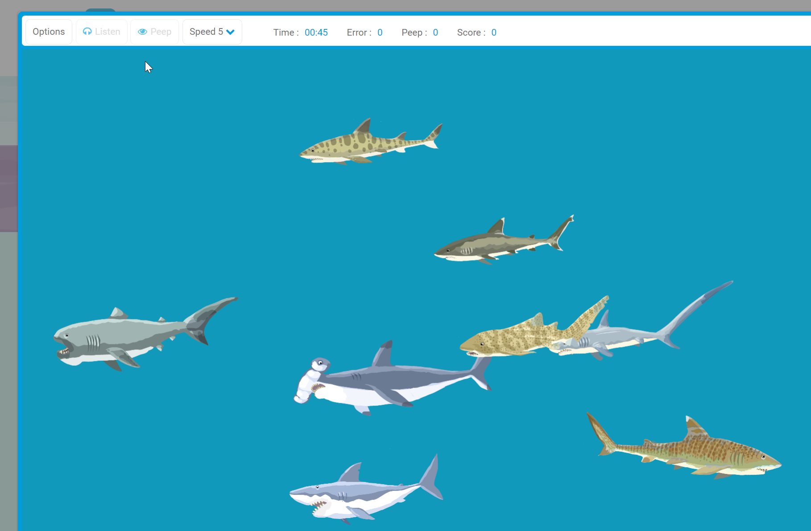
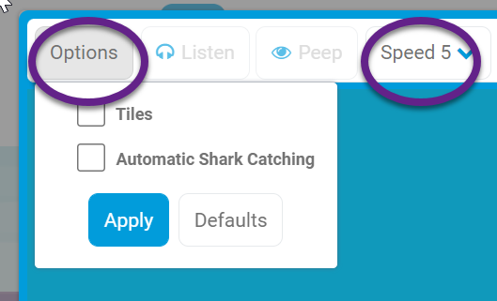
Look out for different games options and speeds
😃

Slide 27
Wordshark online

